Slide 1
Class 3
Trade Deficits;
Currency Manipulation
PubPol 201
Module 3: International Trade Policy

Slide 2

“When a flow becomes a flood”
Jan 22nd 2009 (The Economist print edition)

Slide 3
Class 3 Outline
Trade Deficits; Currency Manipulation
Trade deficits
  Definitions
  What they do and do not mean
  Are they a problem?
Currency manipulation
  How it can be done
  Criteria for naming it
  China’s currency

Slide 4
Class 3 Outline
Trade Deficits; Currency Manipulation
Trade deficits
  Definitions
  What they do and do not mean
  Are they a problem?
Currency manipulation
  How it can be done
  Criteria for naming it
  China’s currency

Slide 5
Definitions
Balance of trade = Exports minus Imports
  “Surplus” if positive
  “Deficit” if negative
Reported in 2 forms
  Balance of trade in goods (aka “merchandise”)
  Balance of trade in goods and services

Slide 6
Definitions
Current Account Balance
  Also includes
    Income from abroad minus income paid to abroad
    Transfer payments into country minus transfer payments out of country
  Thus equals
    Exports minus imports of goods and services plus net income from abroad and net transfer inflows
For most high-income countries, current account balance ≈ balance of trade.

Slide 7
Definitions
Financial Account Balance
  This represents changes in financial stocks
    Net increase in foreign holding of assets here Minus
    Net increase in domestic holdings of assets abroad
  Thus it is approximately our country’s net borrowing from abroad

Slide 8
Definitions
How the balances fit together
It must be true (if measured perfectly) that
Thus a financial account surplus could be said to “finance” a current account deficit
Current Account Balance
+
Financial Account Balance
= 0

Slide 9
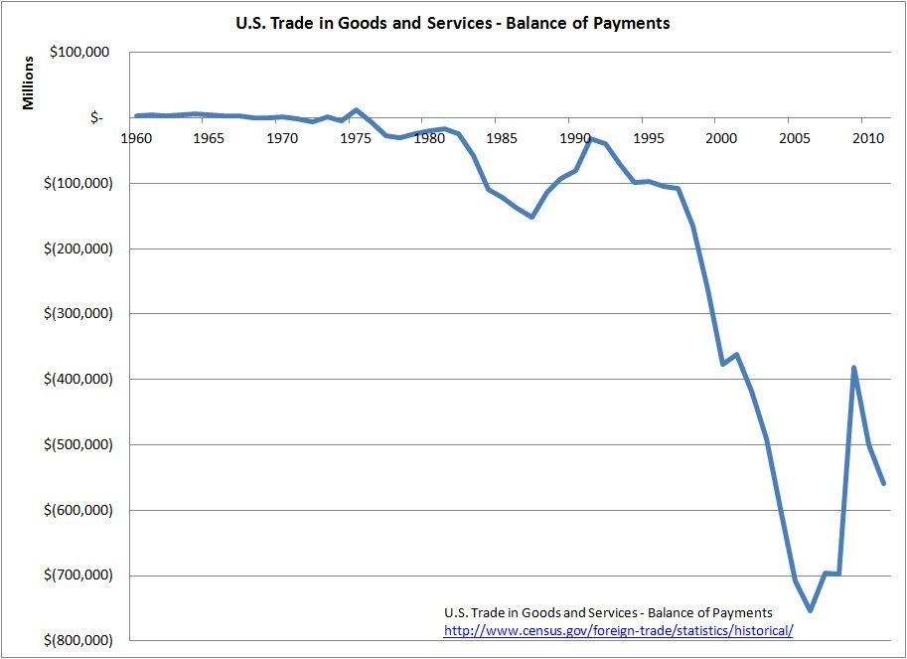
US Trade Deficit, in $ million
Notes:
https://ourfuture.org/20150113/rep-alan-grayson-explains-trade-deficit-harm

Slide 10
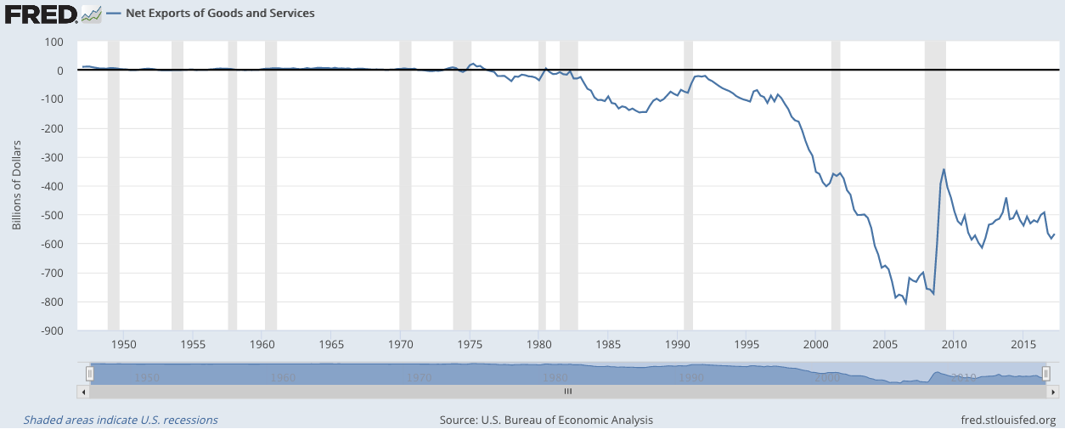
US Trade Deficit, in $
Note that trade deficit shrinks in recessions
Notes:
https://fred.stlouisfed.org/series/NETEXP

Slide 11
Trade Deficits and GDP/Unemployment
As noted above, trade deficits
  Tend to decline in recessions,
  And be largest in booms
Does this mean deficits either
  Cause booms, or
  Cause recessions?
Some say yes, but this is an example of what Professor Hall calls “causal confusion”
  See below.

Slide 12
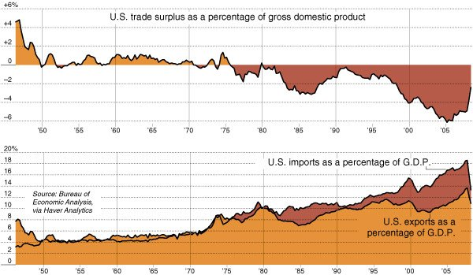
US Trade & Trade Deficit, in % of GDP
Notes:
http://www.nytimes.com/2009/05/02/business/02charts.html

Slide 13
US Bilateral Trade
Trade in goods, 2017, $ millions
US Bilateral Deficits, Largest
Country | Exports | Imports | Total | Deficit
China | 129,894 | 505,470 | 635,364 | -375,576
EU | 283,269 | 434,633 | 717,902 | -151,363
Mexico | 243,314 | 314,267 | 557,581 | -70,953
Japan | 67,605 | 136,481 | 204,086 | -68,876
Germany | 53,897 | 117,575 | 171,472 | -63,678
US Bilateral Surpluses, Largest
Country | Exports | Imports | Total | Deficit
Hong Kong | 39,939 | 7,376 | 47,315 | +32,563
Netherlands | 41,510 | 17,785 | 59,295 | +23,725
U.A.E. | 20,020 | 4,269 | 24,289 | +15,751
Belgium | 29,924 | 14,997 | 44,921 | +14,927
Australia | 24,527 | 10,045 | 34,572 | +14,482
Notes:
From http://www.trade.gov/mas/ian/build/groups/public/@tg_ian/documents/webcontent/tg_ian_003364.pdf
Via https://en.wikipedia.org/wiki/List_of_the_largest_trading_partners_of_the_United_States#cite_note-2
(But numbers don’t quite match. Don’t know why.)

Slide 14
Country balances overall (not bilateral) $
Current account balances, 2017, $ billions
Deficits, Largest
Country | Deficit
US | -466.2
UK | -106.7
India | -51.2
Canada | -49.3
Turkey | -47.1
Surpluses, Largest
Country | Deficit
EU | +404.9
Germany | +296.6
Japan | +195.4
China | +164.9
Netherlands | +80.9
Notes:
CIA World Factbook: https://www.cia.gov/library/publications/the-world-factbook/rankorder/2187rank.html

Slide 15
Country balances overall (not bilateral) %GDP
Current account balances, 2016, & rank of 74
Deficits, Selected Largest
Country | Rank | Deficit
Bhutan | 1 | -27.7
UK | 14 | -4.4
Canada | 23 | -3.3
Australia | 28 | -2.7
US | 31 | -2.6
Surpluses, Selected Largest
Country | Rank | Deficit
Singapore | 1 | +19.0
Switzerland | 2 | +10.7
Germany | 4 | +8.3
Japan | 17 | +3.8
China | 22 | +1.8
Notes:
World Bank: https://data.worldbank.org/indicator/BN.CAB.XOKA.GD.ZS?name_desc=false

Slide 16
Class 3 Outline
Trade Deficits; Currency Manipulation
Trade deficits
  Definitions
  What they do and do not mean
  Are they a problem?
Currency manipulation
  How it can be done
  Criteria for naming it
  China’s currency

Slide 17
What the Trade Balance
Does Not Mean
Common Misinterpretations
  That a deficit means we are “losing money”
    This was sort of true
      When
        All money was gold (the Gold Standard), and
        There were no international capital flows
      Then imports > exports meant you were spending more gold than you were earning; Gold was flowing out
    Today there are capital flows
      A country with imports > exports can
        Borrow
        Sell assets to foreigners

Slide 18
What the Trade Balance
Does Not Mean
Common Misinterpretations
  That a deficit means we are “losing jobs”
    It is true that
      Imports are goods we don’t produce, and
      Exports are goods we do produce
    But whether an increase in imports means a loss of jobs depends on why imports went up
      Often it is because more people are working, earning income, and buying more from abroad

Slide 19
What the Trade Balance
Does Not Mean
Common Misinterpretations
  That a deficit means other countries are misbehaving, by restricting imports or subsidizing exports
    No

Slide 20
What the Trade Balance
Does Not Mean
Common Misinterpretations
  President Trump sees deficits as meaning that we are being taken advantage of in trade agreements
    "The United States has an $800 Billion Dollar Yearly Trade Deficit because of our 'very stupid' trade deals and policies," tweeted President Trump in March. As result, he said, "our jobs and wealth are being given to other countries."
    No
Notes:
https://www.businessinsider.com/trump-trade-jobs-wealth-dont-correlate-with-trade-balance-2018-6

Slide 21
What the Trade Balance
Does Mean
From National Income Accounting
    (I’ll do this first without government)
  Recall from Econ 102 (if you’ve had it)
  GDP = Output = Income = Y
  Output:
  Y = C + I + (X − M)
  Income:
  Y = C + S
  Therefore
  X − M = S − I
Where
  C = Consumption
  I = Investment
  X = Exports
  M = Imports
  S = Savings

Slide 22
What the Trade Balance
Does Mean
From National Income Accounting
  Thus, since X − M = S − I
    Trade surplus ⇒ savings > investment
    Trade deficit ⇒ savings < investment
  If we are not saving enough to finance investment, how do we pay for it?
    By borrowing from abroad, or
    By selling assets

Slide 23
What the Trade Balance
Does Mean
From National Income Accounting
    (This time with government)
  Even more simply
  Y = C + I + G + (X − M)
  implies
  X − M = Y − (C + I + G)
Where
  G = Government purchases of goods & services (not transfer payments)

Slide 24
What the Trade Balance
Does Mean
Thus
(X − M) = Y − (C + I + G)
  So a trade deficit
  (X − M) < 0
  means that we are spending
  (C + I + G)
  more than our income Y
Trade Surplus
Income
Expenditure

Slide 25
What the Trade Balance
Does Mean
Therefore, in spite of its name, and it’s definition, the trade balance
  Is not really about trade, which is just the symptom
  It is about whether we are living within our means
If we are spending more than our income
  Then we are buying more than we are producing
  And we must import the difference
    Thus running a trade deficit

Slide 26
Trade Deficits and GDP/Unemployment
Do deficits either
  Cause booms, or
  Cause recessions?
No. Causation is the other direction
  When income rises in a boom, so does spending, and trade deficit grows
  When income falls in a recession, so does spending and the trade deficit shrinks

Slide 27
Class 3 Outline
Trade Deficits; Currency Manipulation
Trade deficits
  Definitions
  What they do and do not mean
  Are they a problem?
Currency manipulation
  How it can be done
  Criteria for naming it
  China’s currency

Slide 28
Are Trade Deficits a Problem?
Mankiw reading
  Mankiw is a Harvard professor.
    He was also Chair of Council of Economic Advisors under George W. Bush
    And later advisor to Mitt Romney
  He makes several points:
    Money that flows out for imports comes back for exports and capital inflows
    Deficit was largest when unemployment was lowest, because high income causes high imports
    Trump’s intended policies (e.g., tax cuts, infrastructure spending) will increase the trade deficit

Slide 29
Clicker Question
According to Mankiw, how would a large increase in US tariffs affect US exports, and why?
  There would be no effect, because tariffs apply to imports, not exports
  Exports would rise, because revenue from tariffs would be used to produce exports
  Exports would fall, because the US dollar would become worth more
✓

Slide 30
Are Trade Deficits a Problem?
When is a trade deficit good?
  When the country (like a young person) is investing for the future (like a successfully developing country)
  Not when it is going into debt just to finance current consumption (like the US)

Slide 31
Are Trade Deficits a Problem?
Lankford reading
  Note that the author of this opinion piece is a Republican senator (from Oklahoma)
  He makes two points:
    That our trade deficit with Mexico is due to our much higher income. We can afford to buy more than they can, and hence we do.
    The deficit also reflects the fact the foreigners want to invest in the US and when they do, that money flowing in for investment requires that money flow out in a trade deficit. But foreign investment into the US benefits us.

Slide 32
Are Trade Deficits a Problem?
Lankford reading
  His first point is suspect.
    US per capita income is higher
    But that doesn’t mean that our consumption can exceed our income by more, as a deficit implies
    Unless, perhaps, it means we have better credit and can borrow
  His second point is good
    Foreigners’ investments here are inflows in the Financial Account
    They must be matched by outflows in the current account

Slide 33
Clicker Question
What prompted this Republican senator to argue in favor of the US trade deficit?
  The needs of his state, Oklahoma, to increase its imports
  Trump’s NAFTA goal of reducing the trade deficit with Mexico
  Democrat’s policies of added spending that will increase the trade deficit
✓

Slide 34
What about Bilateral imbalances?
There is no reason why bilateral trade should be balanced
  Depending on who is exporting and importing what, it may make sense for a country to
    Mainly buy (import) from one country, and
    Mainly sell (export) to another country
Example
  China has lots of labor but few natural resources
    So it imports resources from Australia, and
    Exports manufactures to the US

Slide 35
What about Bilateral imbalances?
Can tariffs change bilateral imbalances?
  Yes
  Tariffs on one country won’t change how much we import overall, but they can change from whom we import
  The tariff on imports from China should
    Reduce our bilateral deficit with China
    Increase our deficit with other countries, as we import the goods from them instead of from China

Slide 36
Discussion Question
Why do President Trump and others see trade deficits of the US, both overall and bilateral, as bad?
Do they see them as signs of bad US policies or of bad policies of other countries?

Slide 37
Class 3 Outline
Trade Deficits; Currency Manipulation
Trade deficits
  Definitions
  What they do and do not mean
  Are they a problem?
Currency manipulation
  How it can be done
  Criteria for naming it
  China’s currency

Slide 38
Exchange Rates
How are they determined?
  By markets – supply and demand
    In countries with a “floating exchange rate,” that’s all:
      US, EU, Canada, Mexico, and others
  By governments intervening in markets
    Selling their own currency and buying others to push their currency down
    Buying their own currency and selling others to push their currency up

Slide 39
Exchange Rates
Exchange-market intervention
  Is done, if at all, by the Central Bank (CB)
  Requires “International Reserves”
    Of foreign currencies (usually the US dollar), or
    Of foreign assets denominated in foreign currency
  Reserves
    Rise when intervention pushes down the domestic currency (since CB buys $)
    Fall when intervention pushes up the domestic currency (since CB sells $)

Slide 40
Exchange Rates
Currency Manipulation
  Usually defined as intervention intended to reduce the value of a country’s own currency
    In order to make its exports more competitive, and
    Discourage imports
  Other countries object to it, because it reduces their exports
  Congress requires the US Treasury Department to report twice a year on currency manipulation

Slide 41
Exchange Rates
Currency Manipulation
  Many have accused China, especially, of currency manipulation over the years
  Trump promised, during the campaign, to label China a currency manipulator “on his first day in office.” He did not.
  Had he done so, according to the FT reading, it
    would have authorized “the US to do nothing except negotiate with Beijing over the renminbi, which it is already doing.”

Slide 42
Exchange Rates
Currency Manipulation
  In September 2018, Trump told Reuters: “I think China's manipulating their currency, absolutely. And I think the euro is being manipulated also.”
  In October 2018, the fourth such report under Trump did not label China a currency manipulator
Notes:
https://seekingalpha.com/article/4207807-trump-renews-charges-chinese-currency-manipulation
https://www.nytimes.com/2018/10/17/business/china-currency-manipulation.html

Slide 43
Class 3 Outline
Trade Deficits; Currency Manipulation
Trade deficits
  Definitions
  What they do and do not mean
  Are they a problem?
Currency manipulation
  How it can be done
  Criteria for naming it
  China’s currency

Slide 44
Exchange Rates
US criteria for currency manipulation: To be labelled a currency manipulator, a country must
    (As of April 2016, per Bergsten-Gagnon reading)
  Have $55 billion or more of annual trade with the United States (to count as a “major trading partner”);
    (Economist reading omits this)
  Run a bilateral trade surplus with the United States exceeding $20 billion over the past 12 months;
  Run a global current account surplus exceeding 3 percent of the country’s GDP over the past 12 months; and
  Engage repeatedly in net foreign exchange purchases exceeding 2 percent of the country’s GDP over the past 12 months.

Slide 45
Clicker Question
Which of the 4 criteria do Bergsten and Gagnon say should be dropped?
  $55 billion or more of annual trade with the United States
  bilateral trade surplus with the United States exceeding $20 billion
  global current account surplus exceeding 3 percent of GDP
  net foreign exchange purchases exceeding 2 percent of GDP
✓
Because bilateral trade balance means nothing about currencies

Slide 46
Class 3 Outline
Trade Deficits; Currency Manipulation
Trade deficits
  Definitions
  What they do and do not mean
  Are they a problem?
Currency manipulation
  How it can be done
  Criteria for naming it
  China’s currency

Slide 47
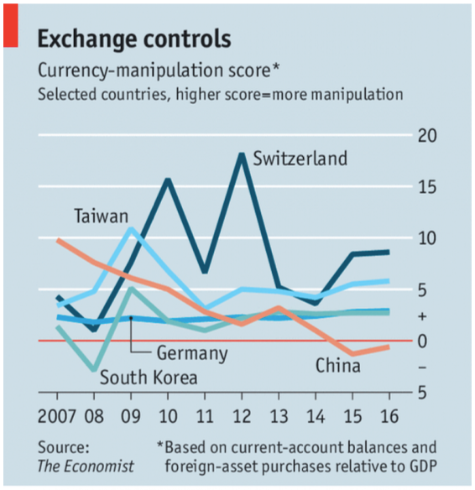

Slide 48
How a Floating Exchange Rate Behaves
US$/euro Exchange Rate
It moves up and down a lot.

Slide 49
China’s Exchange Rate, US$/Yuan, 2000-2018
The exchange rate did not change at all between 2000 and 2005
Notes:
China currency.xlsx
From IMF, IFS

Slide 50
And reserves more than quadrupled!
Notes:
See China Currency.xlsx

Slide 51
Currency Manipulation
The US Dollar vs Chinese Renminbi
  It is clear from the two graphs that
    China was pegging their currency to the US dollar in 2000-2005
    To do so they were buying dollars and thus accumulating almost $1 trillion of reserves
  This led policy makers in the US to complain, and in 2005 China let its currency rise

Slide 52
China’s Exchange Rate, US$/Yuan, 2000-2018
The yuan appreciated steadily between 2005 and 2008
Notes:
China currency.xlsx
From IMF, IFS

Slide 53
Currency Manipulation
But China’s reserves continued to rise, indicating that it was still buying dollars.

Slide 54
Reserves continued to rise, to almost $2 trillion
Notes:
See China Currency.xlsx

Slide 55
Currency Manipulation
The financial crisis of 2008 slowed down both
  The appreciation of the renminbi, and
  The growth of reserves

Slide 56
China’s Exchange Rate, US$/Yuan, 2000-2018
The yuan stopped rising in 2008, then rose slowly
Notes:
China currency.xlsx
From IMF, IFS

Slide 57
Reserves mostly rose after 2008, to over $4 trillion in 2014
Notes:
See China Currency.xlsx

Slide 58
Currency Manipulation
The financial crisis of 2008
  Slowed down the appreciation of the renminbi, off and on
  But reserves continued to grow rapidly in most periods until 2014
  China’s purchases of US dollars were still holding down the yuan’s value, or slowing its rise
But all that changed in 2014

Slide 59
China’s Exchange Rate, US$/Yuan, 2000-2018
The yuan reached its peak in 2013, and began to fall in 2015
Notes:
China currency.xlsx
From IMF, IFS

Slide 60
From 2014-16, China’s reserves were falling
Notes:
See China Currency.xlsx

Slide 61
Currency Manipulation
Starting in 2014
  The renminbi fell against the US dollar
  Chinese reserves declined, by almost $1 trillion
  This means that China’s CB was
    Selling dollars, not buying them
    Thus pushing the dollar down, not up
    And the renminbi up, not down.
  So China WAS intervening
  But not to push its currency down

Slide 62
China’s Exchange Rate, US$/Yuan, 2000-2018
Most recently, the yuan has moved up in 2017, down in 2018
Notes:
China currency.xlsx
From IMF, IFS

Slide 63
While reserves have moved little
Notes:
See China Currency.xlsx

Slide 64
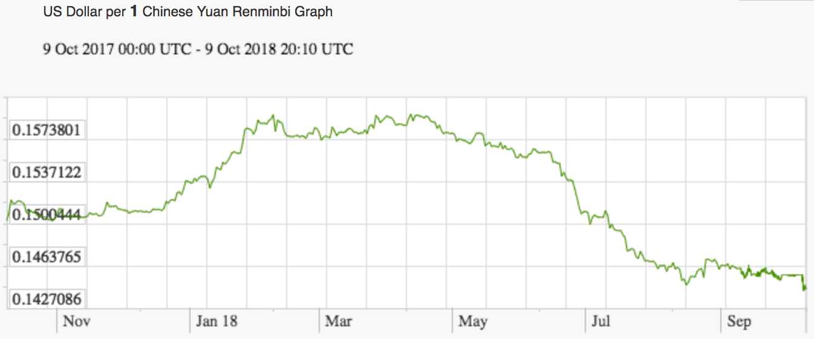
Currency Manipulation
Recent movements of the Chinese currency
9%

Slide 65
Clicker Question
Over the last 20 years, how many countries have been named as currency manipulators in the semi-annual Treasury reports?
  0
  1
  2
  3
  4
✓

Slide 66
Clicker Question
Which of the following countries is not mentioned as being on the Treasury Department’s monitoring list for currency manipulation?
  Germany
  Japan
  Mexico
  South Korea
  Switzerland
✓
See reading by Talley for the others

Slide 67
Discussion Question
In 2008, responding to the financial crisis and global recession, the US Fed used a new method to push down US interest rates. This caused the US dollar to depreciate, and other countries complained that this was making it harder for them to compete and deal with their own recessions.
Was the US engaged in currency manipulation? Were the complaints justified?

